Slide 1
What is CSS?
Cascading Stylesheets
NOT a programming language
Stylesheet/Styling language
Used for website layout and design
Can be extended with Sass/Less

Slide 2
What We Need To Start
A Web Browser (Pick One)
- Google Chrome
- Mozilla Firefox
- Safari
- Edge
- IE (Please Don’t)
A Text Editor (Pick One)
- Sublime Text
- Atom.io
- Visual Studio Code
- Brackets
- Notepad++ (Windows)
- TextMate (Mac)

Slide 3
3 Methods For Adding CSS
Inline CSS: Directly in the html element (NO!)
Internal CSS: Using <style> tags within a single document
External CSS: Linking an external .css file

Slide 4
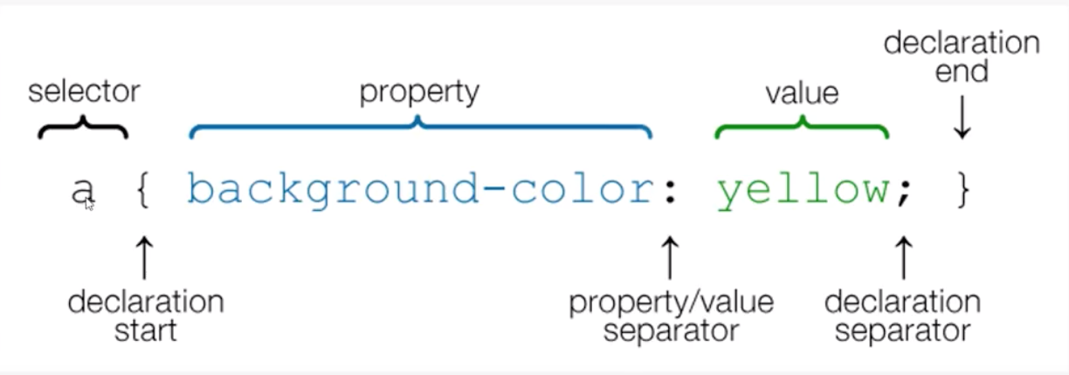
CSS Selectors

Slide 5
Colors in CSS
Color Names
HTML5 Color names
Hexadecimal
RGB
body {
color: red;
background: coral
}
h1 {
color: #00ff00;
}
p {
color: rgb(0,0,255);
}

Slide 6
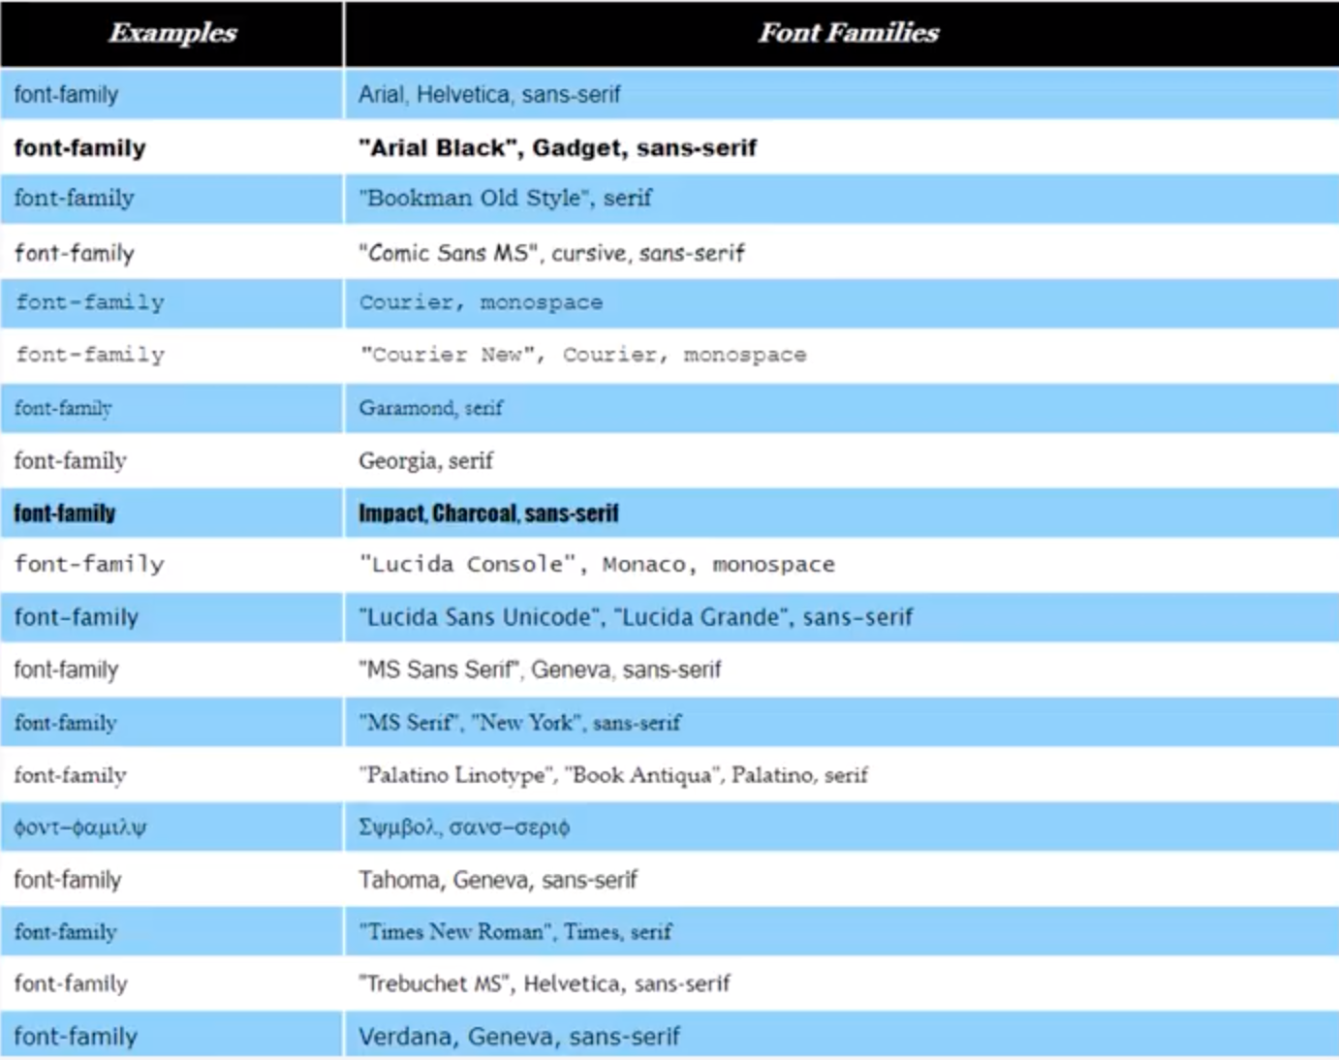
Web Safe Fonts

Slide 7
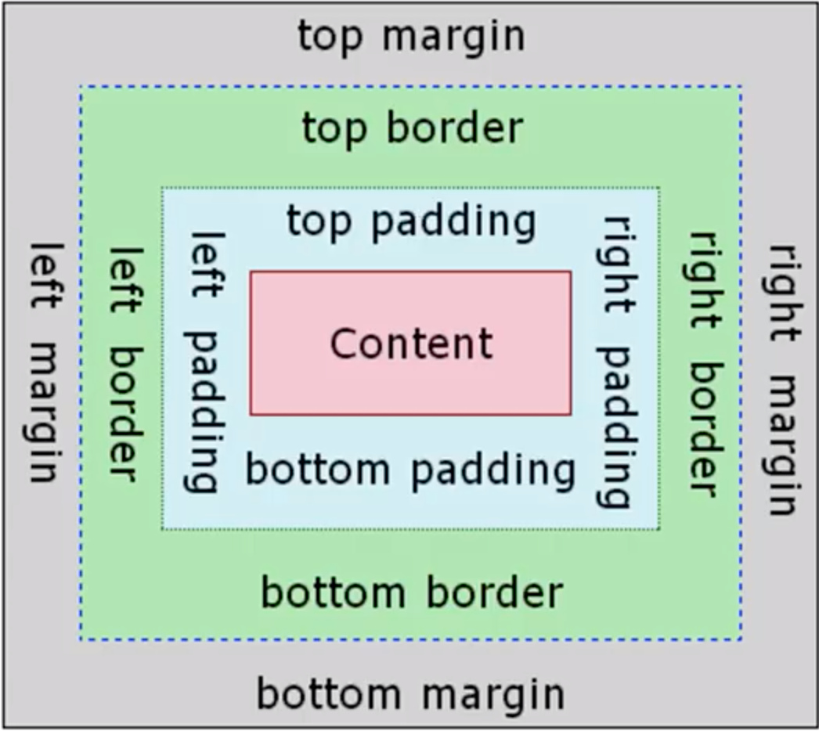
Box Model

Slide 8
Margin & Padding Shorthand
Long Way
p {
margin-top:5px;
margin-bottom;5px;
margin-right:10px;
margin-left:10px;
}
Short Way
-top, right, bottom, left
p {
margin: 5px 10px 5px 10px;
}
-If you want top and bottom and left and right to have same size, you can use the syntax: top and bottom, left and right
p {
margin: 5px 10px;
}

Slide 9
Positioning in CSS
Static
- Default value. Elements render in order, as they appear in the document flow
Relative
- The element is positioned relative to its normal position, so "left:20px" adds 20 pixels to the element's LEFT position
Absolute
- The element is positioned relative to its first positioned (not static) ancestor element
Fixed
- The element is positioned relative to the browser window
Initial
- Sets this property to its default value.
Inherit
- Inherits this property from its parent element.

